Slide 1

Food Recognition and Calorie Measurement Using Image Processing

Slide 2
Team Members
Bhargava Reddy P - 19BCE1342
Lingam V V S N Datta Sai - 19BCE1373
B Jivitesh - 19BCE1275

Slide 3
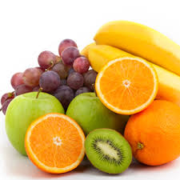
Abstract
Computer vision has been introduced to estimate calories from food images. But current food image datasets don't contain volume and mass records of foods, which leads to an incomplete calorie estimation. We present a image dataset with volume and mass records of foods, and a deep learning method for food detection, to make a complete calorie estimation. Our dataset includes 2978 images, and every image contains corresponding each foods annotation, volume and mass records, as well as a certain calibration reference.

Slide 4
Introduction
Obesity is a medical condition in which excess body fat has accumulated to the extent that it may have a negative effect on health. People are generally considered obese when their Body Mass Index(BMI) is over 30 kg/m2 . High BMI is associated with the increased risk of diseases, such as heart disease, type two diabetes, etc. The main cause of obesity is the imbalance between the amount of food intake and energy consumed by the individuals.
In most of the cases, patients have troubles in estimating the amount of food intake because of the self-denial of the problem, lack of nutritional information, the manual process of writing down this information, and other reasons. Obesity treatment requires the patients to eat healthy food and decrease the amount of daily calorie intake, which needs patients to calculate and record calories from foods every day
While computer vision-based measurement methods were introduced to estimate calories from images directly according to the calibration object and foods information, obese patients have benefited a lot from these methods

Slide 5
Problem Statement
The problem can be simply stated as, given a set of food images with calibration object thumb with the food name and an unlabeled set of food images from the same group of food, identify food and estimate food volume and calories intake.

Slide 6
Data Collection
For this project I used two datasets:
1. FOODD
2. ECUST Food Dataset (ECUSTFD)
The dataset contains images taken with different cameras, illuminations, and angles. Having a wide variety of food and foods gives a better and more reliable dataset in order to increase the accuracy of calorie food measurement systems

Slide 7
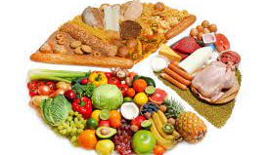
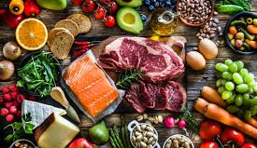
Modules
Calorie Estimation Method Based On Deep Learning
Objection detection With Deep Learning Methods
Image Segmentation
Volume Estimation And Calorie Calculation

Slide 8
Proposed Methodology
The problem can be simply stated as, given a set of food images with calibration object thumb with the food name and an unlabeled set of food images from the same group of food, identify food and estimate food volume and calories intake.
First we have to collect data of datasets which are being used.
Food Recognition deals with recognition of food item when given an image. For this problem we use Convolutional Neural Network (CNN)
And then later use image segmentation methods to obtain the contour of the food and thumb.
At last we use estimation methods and formulae to calculate the calories of the food.

Slide 9
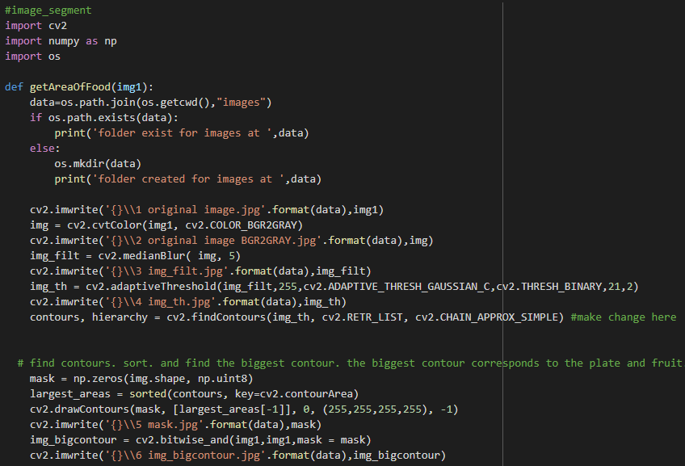
Results

Slide 10
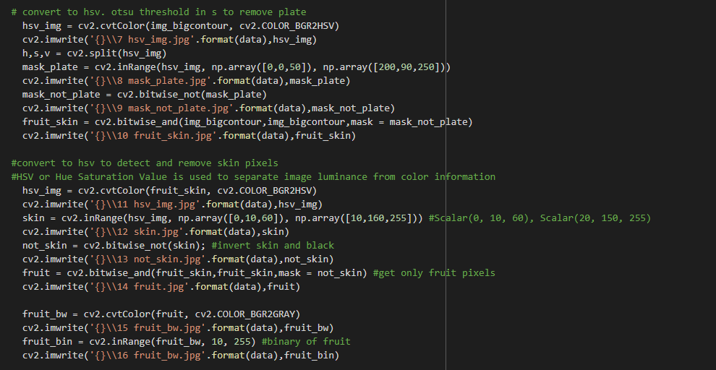

Slide 11
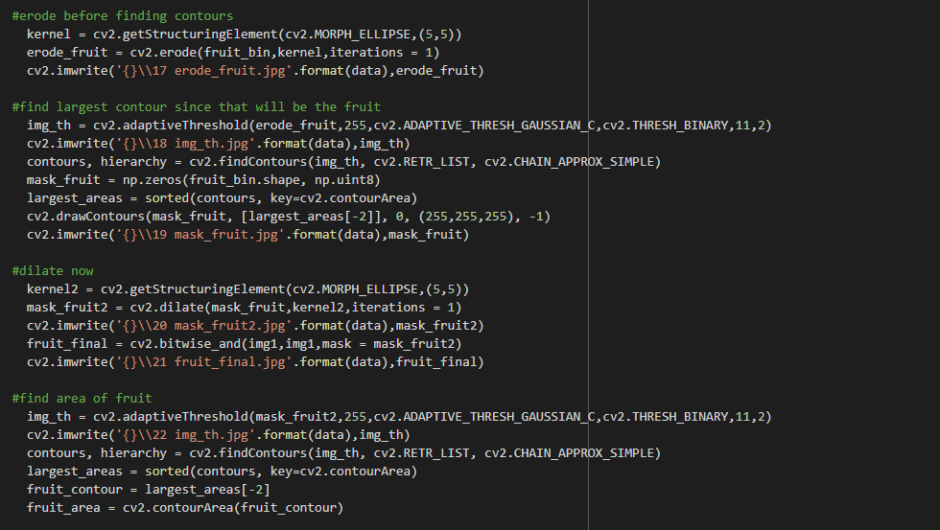

Slide 12
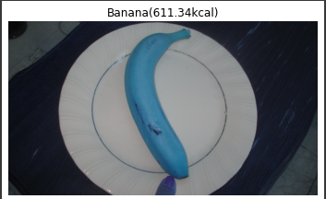
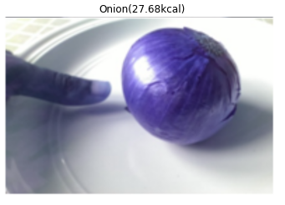
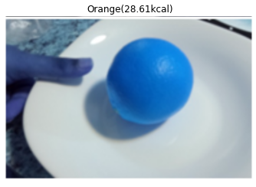

Slide 13
Conclusion
In practice, the traditional models in machine learning are not attaining much accuracy when it comes to image classification. In this project, the CNN model is applied in image recognition.Much of data augmentation and segmentation has to be performed as well and clean pixel values are not necessary in CNN as it on it’s own learn the generalized pattern required to identify and recognize new images.So using CNN model, the accuracy is comparatively a lot higher than all other traditional models.

Slide 14
THANK YOU

